Slide 1
NVIDIA INT8
Weiguang Yang, 2017.09.26

Slide 2
NVIDIA INT8
GTC China 2017 Community Corner
什么是 NVIDIA INT8 ?
如何使用 NVIDIA INT8 ?
INT8 最大的挑战是什么?
综合评价 NVIDIA INT8的几种使用方式

Slide 3
什么是 NVIDIA INT8 ?

Slide 4
什么是 NVIDIA INT8 ?
A
float
float
float
float
×
B
float
float
float
float
=
C
float
四次乘法+四次加法
https://devblogs.nvidia.com/parallelforall/mixed-precision-programming-cuda-8/

Slide 5
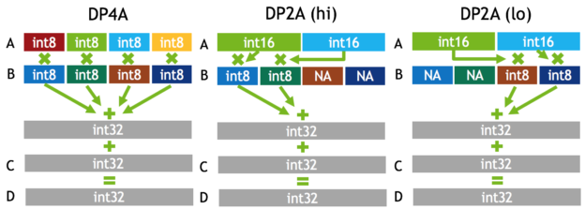
什么是 NVIDIA INT8 ?
A
float
float
float
float
×
B
float
float
float
float
=
C
float
High Performance with Low-Precision Integers
四次乘法+四次加法
一次dp4a
https://devblogs.nvidia.com/parallelforall/mixed-precision-programming-cuda-8/

Slide 6
什么是 NVIDIA INT8 ?
A
float
float
float
float
×
B
float
float
float
float
=
C
float
High Performance with Low-Precision Integers
理论上4倍加速
四次乘法+四次加法
一次dp4a
模型压缩75%
https://devblogs.nvidia.com/parallelforall/mixed-precision-programming-cuda-8/

Slide 7
INT8 加速技术成功案例
硬件
Google TPU
NVIDIA INT8
Intel
SSE
软件
float
float
float
float
=
C
float

Slide 8
如何使用 NVIDIA INT8 ?
TensorRT
cublas
cudnn
神经网络线上推理加速库
TensorRT 1支持FP16加速，Tensor 2支持INT8加速
Sample text placed here
Best to keep information no more than 5 bullet points long
Should be used to distinguish buckets of information across multiple columns
Sample text placed here
Best to keep information no more than 5 bullet points long
Should be used to distinguish buckets of information across multiple columns

Slide 9
如何使用 NVIDIA INT8 ?
TensorRT

Slide 10




Color palette
Primary
NVIDIA green
R: 118
G: 185
B: 0
Colors for charts
Neutrals
Gaming
Enterprise Graphics
Datacenter
Auto
Technology
Light gray
Competitor colors
Medium green
Medium gray
Dark green
Black

Slide 11
Table sample
 | CATEGORY ONE | CATEGORY TWO | CATEGORY THREE
Trebuchet bold, 18 pt | Trebuchet, 16 pt | Text | Text
Row one | Text | Text | Text
Row two | Text | Text | Text
Row three | Text | Text | Text
Source: Source information is 8 pt, italic

Slide 12
Pie chart sample
15%
15%
40%
25%
20%
Source: Source information is 8 pt, italic

Slide 13
Bar chart sample
Y-axis text goes here
Y-axis text goes here
Source: Source information is 8 pt, italic

Slide 14
Line chart sample
Y-axis text goes here
Y-axis text goes here
Source: Source information is 8 pt, italic

Slide 15
Timeline
January 25
XYZ Launch
November 30
xxxx
October 10
xxxx
December 3
xxxx
February 12
xxxx
October
November
December
January 2016
February
Source: Source information is 8 pt, italic

Slide 16

Video file
Inserting video: Insert/Video/Video from File.
Insert video by browsing your directory and selecting OK.
File type that works best in PowerPoint is: .wmv

Slide 17
DEMO: Placeholder (insert picture behind gray bar)

Slide 18
Compare or contrast sample
Column one
Column two
Column three
Sample text placed here
Best to keep information no more than 5 bullet points long
Should be used to distinguish buckets of information across multiple columns
Sample text placed here
Best to keep information no more than 5 bullet points long
Should be used to distinguish buckets of information across multiple columns
Sample text placed here
Best to keep information no more than 5 bullet points long
Should be used to distinguish buckets of information across multiple columns

Slide 19
Box diagram
Text only descriptors
Title here
Title here
Supporting text here
Supporting text here
Title here
Title here
Supporting text here
Supporting text here

Slide 20




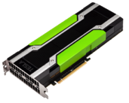
Box diagram
Title with images
Title here
Title here
Title here
Title here

Slide 21




Product slide

Slide 22
Stat example
65%
25%
10%
Supporting text goes here
[Use green for POSITIVE]
Text goes here
[Use red for NEGATIVE]
Text goes here
[Use gray for NUETRAL]

Slide 23

Photo caption

Slide 24

Text slide with photograph
Optional subtitle
Text goes here
Text goes here

Slide 25

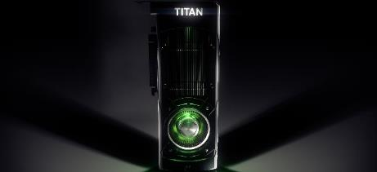

Text slide with photographs
Multiple images
Allow a consistent “gutter” space between images
Use a gray outline (R: 90, G: 90, B: 90) at 0.5 pt

Slide 26
“ Quoted text example goes here. Trebuchet, 42 pt. Use with shorter (headline type) quotes.”
Quote Source, Trebuchet 20 pt

Slide 27
“ Quoted text example goes here. Trebuchet, 42 pt. Use with shorter (headline type) quotes.”
— Source, Trebuchet 18 pt

Slide 28


“Multi-quote slide sample.”
— Source: Either a name or publication text here, OR, a company logo to the right
“Multi-quote slide sample.”
— Source: Either a name or publication text here, OR, a company logo to the right
“Multi-quote slide sample.”
— Source: Either a name or publication text here, OR, a company logo to the right

Slide 29




Customer success story
ADD CUSTOMER LOGO HERE
Optional subtitle
Challenge
Ei eos viris putant, veritus deserunt et qui.
Ea his diam labore prodesset, ei justo atomorum per.
Ei ullum utinam recteque cum. Quem tota dici
Solution
Ei eos viris putant, veritus deserunt et qui.
Ea his diam labore prodesset, ei justo atomorum per.
Ei ullum utinam recteque cum. Quem tota dici
Impact
Ei eos viris putant, veritus deserunt et qui.
Ea his diam labore prodesset, ei justo atomorum per.
Ei ullum utinam recteque cum. Quem tota dici

